Slide 1
Module 6
Network Security

Slide 2
Network Security
The protection afforded to an automated information system in order to attain the applicable objectives of preserving the integrity, availability, and confidentiality of information system resources (includes hardware, software, firmware, information/ data, and telecommunications).
This definition introduces three key objectives that are at the heart of computer security.
Confidentiality
Integrity
Availability

Slide 3
Network Security Concepts
Confidentiality: This term covers two related concepts:
Data confidentiality: Assures that private or confidential information is not made available or disclosed to unauthorized individuals.
Privacy: Assures that individuals control or influence what information related to them may be collected and stored and by whom and to whom that information may be disclosed.
Integrity: This term covers two related concepts:
Data integrity: Assures that information and programs are changed only in a specified and authorized manner.
System integrity: Assures that a system performs its intended function in an unimpaired manner, free from deliberate or inadvertent unauthorized manipulation of the system.
Availability: Assures that systems work promptly and service is not denied to authorized users. These three concepts form what is often referred to as the CIA triad .
NOTE
The three concepts embody the fundamental security objectives for both data and for information and computing services.

Slide 4
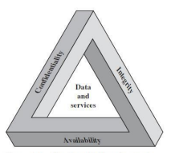
The CIA triad

Slide 5
Other security requirements
Authenticity: The property of being genuine and being able to be verified and trusted; confidence in the validity of a transmission, a message, or message originator.
This means verifying that users are who they say they are and that each input arriving at the system came from a trusted source.
Accountability: The security goal that generates the requirement for actions of an entity to be traced uniquely to that entity.
This supports non-repudiation, deterrence, fault isolation, intrusion detection and prevention, and after-action recovery and legal action. Because truly secure systems are not yet an achievable goal, we must be able to trace a security breach to a responsible party. Systems must keep records of their activities to permit later forensic analysis to trace security breaches or to aid in transaction disputes.

Slide 6
The challenges of computer security
Security is not as simple as it might first appear to the novice. The requirements seem to be straightforward; indeed, most of the major requirements for security services can be given self-explanatory, one-word labels: confidentiality, authentication, nonrepudiation, integrity. But the mechanisms used to meet those requirements can be quite complex, and understanding them may involve rather subtle reasoning.
In developing a particular security mechanism or algorithm, one must always consider potential attacks on those security features. In many cases, successful attacks are designed by looking at the problem in a completely different way, therefore exploiting an unexpected weakness in the mechanism.
Having designed various security mechanisms, it is necessary to decide where to use them. This is true both in terms of physical placement (e.g., at what points in a network are certain security mechanisms needed) and in a logical sense [e.g., at what layer or layers of an architecture such as TCP/IP (Transmission Control Protocol/Internet Protocol) should mechanisms be placed].
Security mechanisms typically involve more than a particular algorithm or protocol. They also require that participants be in possession of some secret information (e.g., an encryption key), which raises questions about the creation, distribution, and protection of that secret information.

Slide 7
Cont’d
Computer and network security is essentially a battle of wits between a perpetrator who tries to find holes and the designer or administrator who tries to close them. The great advantage that the attacker has is that he or she need only find a single weakness, while the designer must find and eliminate all weaknesses to achieve perfect security.
Security requires regular, even constant, monitoring, and this is difficult in today’s short-term, overloaded environment.
Security is still too often an afterthought to be incorporated into a system after the design is complete rather than being an integral part of the design process.
Many users (and even security administrators) view strong security as an impediment to efficient and user-friendly operation of an information system or use of information.

Slide 8
Best Practices for Securing a Network
1. Access Control
Implement strong access controls, ensuring that users have the minimum necessary privileges.
2. Firewalls and Intrusion Detection/Prevention Systems (IDPS)
Deploy firewalls to monitor and control incoming/outgoing network traffic, and use IDPS for real-time threat detection.
3. Encryption
Encrypt sensitive data during transmission (using protocols like SSL/TLS) and at rest.
4. Network Segmentation:
Segment the network to isolate sensitive areas and control traffic flow.

Slide 9
Best Practices for Securing a Network
5. Regular Security Audits and Monitoring
Conduct regular security audits and monitor network activities for anomalies.
6. Endpoint Security
Use endpoint protection tools, such as antivirus and anti-malware software.

Slide 10
Possible security Vulnerabilities
Weak or default passwords.
Unauthorized access.
Unsecured remote access points.
Inadequate firewall rules.
Unencrypted data transmission, weak encryption algorithms.
Outdated or disabled endpoint protection.

Slide 11
Security Software to Implement Best Practices
Firewall Solutions
Examples: Cisco ASA, Palo Alto Networks, pfSense.
Intrusion Detection/Prevention Systems (IDPS)
Examples: Snort, Suricata, Cisco Firepower.
Encryption Tools
Examples: OpenSSL, BitLocker, VeraCrypt.
Vulnerability Assessment Tools
Examples: Nessus, OpenVAS, Nexpose.
Security Information and Event Management (SIEM) Solutions
Examples: Splunk, LogRhythm, ELK Stack.
Endpoint Protection Software
Examples: Symantec Endpoint Protection, McAfee Endpoint Security, Microsoft Defender.
Access Control Solutions
Examples: Active Directory (Microsoft), Cisco Identity Services Engine (ISE), Duo Security.
Security Audit and Monitoring Tools
Examples: Wireshark, Security Onion, SolarWinds.
Patch Management Tools
Examples: WSUS (Windows Server Update Services), SCCM (System Center Configuration Manager), Ansible.
Network Segmentation Tools
Examples: VLAN configuration, software-defined networking (SDN) solutions.

Slide 12
Vulnerability and hacking
Vulnerability
A vulnerability is a weakness which can be exploited by a threat actor, such as an attacker, to cross privilege boundaries (i.e. perform unauthorized actions) within a computer system.
To exploit vulnerability, an attacker must have at least one applicable tool or technique that can connect to a system weakness. In this frame, vulnerabilities are also known as the attack surface.
Hacking
Hacking is an attempt to exploit a computer system or a private network inside a computer. Simply put, it is the an unauthorized access to or control over computer network security systems for some illicit purpose. One can easily assume them to be intelligent and highly skilled in computers.

Slide 13
Security attacks
Threat
A potential for violation of security, which exists when there is a circumstance, capability, action, or event that could breach security and cause harm. That is, a threat is a possible danger that might exploit vulnerability.
Attack
An assault on system security that derives from an intelligent threat. That is, an intelligent act that is a deliberate attempt (especially in the sense of a method or technique) to evade security services and violate the security policy of a system.

Slide 14
Security attack
A Security attack is any action that compromises the security of information owned by an organization. A useful means of classifying security attacks is in terms of passive attacks and active attacks.
A passive attack attempts to learn or make use of information from the system but does not affect system resources.
An active attack attempts to alter system resources or affect their operation. Passive attacks are in the nature of eavesdropping on, or monitoring of, the goal of the opponent is to obtain information that is being transmitted. Two types of passive attacks are the release of message contents and traffic analysis.

Slide 15
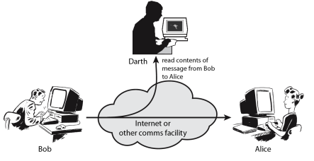
Eavesdropping

Slide 16
Active Attacks
Active attacks involve some modification of the data stream or the creation of a false stream and can be subdivided into four categories: namely:
Masquerade
Replay
modification of messages, and
denial of service.

Slide 17
Active Attacks
A masquerade takes place when one entity pretends to be a different entity. For example, authentication sequences can be captured and replayed after a valid authentication sequence has taken place, thus enabling an authorized entity with few privileges to obtain extra privileges by impersonating an entity that has those privileges.
Replay involves the passive capture of a data unit and its subsequent retransmission to produce an unauthorized effect.
Modification of messages simply means that some portion of a legitimate message is altered, or that messages are delayed or reordered, to produce an unauthorized effect. For example, a message meaning “Allow John Smith to read confidential file accounts” is modified to mean “Allow Fred Brown to read confidential file accounts.”

Slide 18
Active Attacks
The denial of service prevents or inhibits the normal use or management of communications facilities. This attack may have a specific target; for example, an entity may suppress all messages directed to a particular destination (e.g., the security audit service).
Another form of service denial is the disruption of an entire network—either by disabling the network or by overloading it with messages so as to degrade performance. A security-related transformation on the information to be sent. Examples include the encryption of the message, which scrambles the message so that it is unreadable by the opponent, and the addition of a code based on the contents of the message, which can be used to verify the identity of the sender. Some secret information shared by the two principals and, it is hoped, unknown to the opponent. An example is an encryption key used in conjunction with the transformation to scramble the message before transmission and unscramble it on reception.

Slide 19
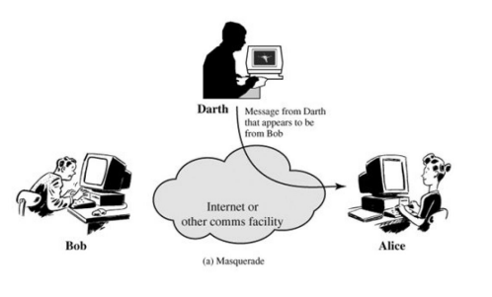
Masquerading

Slide 20
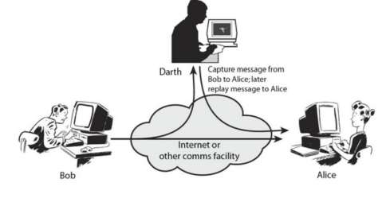
Replay

Slide 21
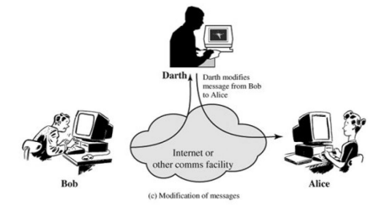
Modification of messages

Slide 22
Denial of Service Attacks
With a DoS attack, a hacker attempts to render a network or an Internet resource, such as a web server, worthless to users.
A DoS attack typically achieves its goal by sending large amounts of repeated requests that paralyze the network or a server. A common form of a DoS attack is a SYN flood, where the server is overwhelmed by embryonic connections.
A hacker sends to a server countless Transmission Control Protocol (TCP) synchronization attempts known as SYN requests. The server answers each of those requests with a SYN ACK reply and allocates some of its computing resources to servicing this connection when it becomes a "full connection."

Slide 23
Examples of security threats
Malware
Viruses: Programs that attach themselves to other software and replicate when that software is executed.
Worms: Self-replicating programs that spread across networks without human intervention.
Trojan Horses: Malicious programs disguised as legitimate software.
Phishing: Deceptive attempts to obtain sensitive information, such as usernames, passwords, and financial details, by posing as a trustworthy entity.
Denial of Service (DoS) and Distributed Denial of Service (DDoS) Attacks:
DoS: Overloading a system or network to make it unavailable to users.
DDoS: Using multiple compromised systems to flood a target with traffic.
Man-in-the-Middle (MitM) Attacks:
Intercepting and potentially altering communications between two parties without their knowledge.
SQL Injection:
Exploiting vulnerabilities in a web application's database by injecting malicious SQL code.

Slide 24
Examples of security threats
Ransomware
Malware that encrypts files on a user's device, demanding payment for their release.
Social Engineering
Manipulating individuals to disclose confidential information through psychological manipulation.
Zero-Day Exploits
Exploiting software vulnerabilities before the vendor releases a fix or patch.
Insider Threats
Malicious actions or data breaches initiated by individuals within an organization, such as employees or contractors.
Password Attacks
Brute Force Attacks: Repeatedly trying different passwords until the correct one is found.
Dictionary Attacks: Trying commonly used passwords or words from a dictionary.

Slide 25
Examples of security threats
Eavesdropping
Unauthorized interception of communication, often in the form of wiretapping or network sniffing.
File less Malware
Malicious code that operates in memory, leaving little to trace on the file system.
DNS Spoofing
Redirecting domain name resolution to a malicious site by providing false DNS responses.
Browser-based Attacks
Exploiting vulnerabilities in web browsers to compromise user data or deliver malware.
Supply Chain Attacks
Compromising a target by targeting vulnerabilities in its supply chain, such as through third-party software or hardware components.
Physical Attacks
Physical tampering with hardware or stealing physical devices to gain unauthorized access.
Notes:
IoT Vulnerabilities:
Exploiting security weaknesses in Internet of Things (IoT) devices.

Slide 26
A model for network security
A Network Security Model exhibits how the security service has been designed over the network to prevent the opponent from causing a threat to the confidentiality or authenticity of the information that is being transmitted through the network.
For a message to be sent or receive there must be a sender and a receiver. Both the sender and receiver must also be mutually agreeing to the sharing of the message. Now, the transmission of a message from sender to receiver needs a medium i.e. Information channel which is an Internet service. A logical route is defined through the network (Internet), from sender to the receiver and using the communication protocols both the sender and the receiver established communication.

Slide 27
A model for network security
Any security service would have the three components discussed below:
Transformation of the information which has to be sent to the receiver. So, that any opponent present at the information channel is unable to read the message. This indicates the encryption of the message. It also includes the addition of code during the transformation of the information which will be used in verifying the identity of the authentic receiver.
Sharing of the secret information between sender and receiver of which the opponent must not any clue. Yes, we are talking of the encryption key which is used during the encryption of the message at the sender’s end and also during the decryption of message at receiver’s end.
There must be a trusted third party which should take the responsibility of distributing the secret information (key) to both the communicating parties and also prevent it from any opponent.

Slide 28
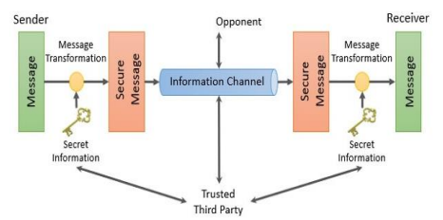
A model for network security

Slide 29
Cryptography
Terminologies of Cryptography:
Cryptography
The many schemes used for encryption constitute the area of study known as cryptography
Crypt analysis
Techniques used for deciphering a message without any knowledge of the enciphering details fall into the area of cryptanalysis. Cryptanalysis is what the layperson calls “breaking the code.”
Cryptology The areas of cryptography and cryptanalysis together are called cryptology
Cipher
Encryption scheme is known as a cryptographic system or a cipher
Plain Text
This is the original intelligible message or data that is fed into the algorithm as input.
Cipher Text
This is the scrambled message produced as output. It depends on the plaintext and the secret key. For a given message, two different keys will produce two different cipher texts

Slide 30
Cryptography
The cipher text is an apparently random stream of data and, as it stands, is unintelligible.
Secret key
The secret key is also input to the encryption algorithm. The key is a value independent of the plaintext and of the algorithm. The algorithm will produce a different output depending on the specific key being used at the time. The exact substitutions and transformations performed by the algorithm depend on the key.
Encryption
The process of converting from plaintext to cipher text
Decryption
The process of restoring the plaintext from the cipher text
Enciphering Algorithm
The encryption algorithm performs various substitutions and transformations on the plaintext
Deciphering Algorithm
This is essentially the encryption algorithm run in reverse. It takes the cipher text and the secret key and produces the original plaintext.

Slide 31
Cryptography
Threat
A potential for violation of security which exists when there is a circumstance, capability, action, or event, that could breach security and cause harm. That is, a threat is a possible danger that might exploit vulnerability.
Attack
An assault on system security that derives from an intelligent threat; that is, an intelligent act that is a deliberate attempt (especially in the sense of a method or technique) to evade security services and violate the security policy of a system.
Security attack:
Any action that compromises the security of information owned by an organization.
Security mechanism:
A process (or a device incorporating such a process) that is designed to detect, prevent, or recover from a security attack.
Security service:
A processing or communication service that enhances the security of the data processing systems and the information transfers of an organization. The services are intended to counter security attacks, and they make use of one or more security mechanisms to provide the service.

Slide 32
Principles of Security
Symmetric Cipher Model
A symmetric encryption scheme has five ingredients. They are Plain Text, Encryption Algorithm, Secret Key, Decryption Algorithm, Cipher Text There are two requirements for secure use of conventional encryption:
We need a strong encryption algorithm. At a minimum, we would like the algorithm to be such that an opponent who knows the algorithm and has access to one or more cipher texts would be unable to decipher the cipher text or figure out the key.
Sender and receiver must have obtained copies of the secret key in a secure fashion and must keep the key secure. If someone can discover the key and knows the algorithm, all communication using this key is readable.

Slide 33
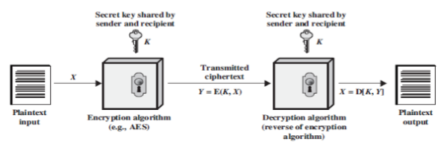
Symmetric Cipher Model

Slide 34
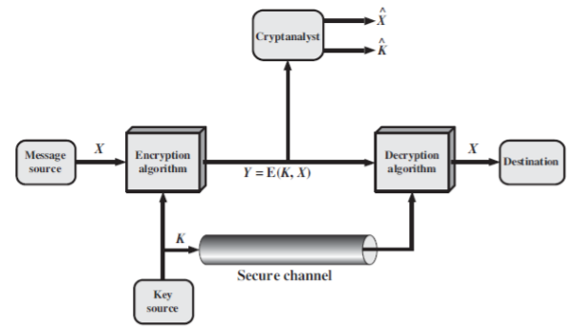
Symmetric Cipher Model

Slide 35
Public key crypto system (Asymmetric cypher model)
The concept of public-key cryptography evolved from an attempt to attack two of the most difficult problems associated with symmetric encryption. The first problem is that of key distribution, and the second one related to digital signature.
Asymmetric algorithms rely on one key for encryption and a different but related key for decryption. These algorithms have the following important characteristic.
It is computationally infeasible to determine the decryption key given only knowledge of the cryptographic algorithm and the encryption key. A public-key encryption scheme has six ingredients
Plaintext: This is the readable message or data that is fed into the algorithm as input.

Slide 36
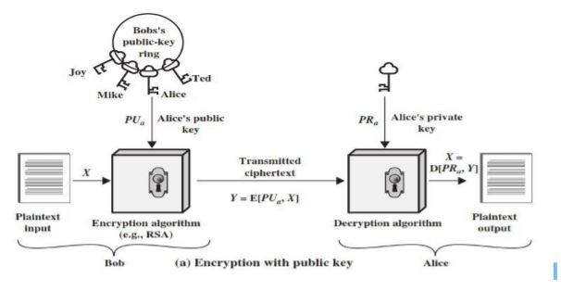
Asymmetric cypher model

Slide 37
Public and private keys:
This is a pair of keys that have been selected so that if one is used for encryption, the other is used for decryption. The exact transformations performed by the algorithm depend on the public or private key that is provided as input.
Cipher text: This is the scrambled message produced as output. It depends on the plaintext and the key. For a given message, two different keys will produce two different cipher texts.
Decryption algorithm: This algorithm accepts the cipher text and the matching key and produces the original plaintext.
Each user generates a pair of keys to be used for the encryption and decryption of messages.
Each user places one of the two keys in a public register or other accessible file. This is the public key. The companion key is kept private. As Figure 3.1, suggests, each user maintains a collection of public keys obtained from others.

Slide 38
Asymmetric key encryption
From the figure above
If Bob wishes to send a confidential message to Alice, Bob encrypts the message using Alice’s public key.
When Alice receives the message, she decrypts it using her private key. No other recipient can decrypt the message because only Alice knows Alice’s private key. With this approach, all participants have access to public keys, and private keys are generated locally by each participant and therefore need never be distributed.
As long as a user’s private key remains protected and secret, incoming communication is secure. At any time, a system can change its private key and publish the companion public key to replace its old public key.

Slide 39
Challenges faced in control and managing encryption keys
Scalability: Managing a large number of encryption keys.
Security: Vulnerability of keys from outside hackers, malicious insiders.
Availability: Ensuring data accessibility for authorized users.
Heterogeneity: Supporting multiple databases, applications and standards.
Governance: Defining policy-driven access control and protection for data

Slide 40
Distribution of public Keys
Several techniques have been proposed for the distribution of public keys.
Virtually all these proposals can be grouped into the following general schemes:
Public announcement
publicly available directory
Public-key authority.
Public-key certificates

Slide 41
Types of cryptanalysis
Cryptanalysis is the science of recovering the plaintext of a message without access to the key. Successful cryptanalysis may recover the plaintext or the key. The two basic categories of cryptanalysis are:
Linear Cryptanalysis and Differential cryptanalysis
Notes:
Types of cryptanalysis
Linear Cryptanalysis:
Linear cryptanalysis is a known plaintext attack, in which the attacker studies probabilistic linear relations known as linear approximations between parity bits of the plaintext, the Cipher text and the secrete key. In this technique, the attacker obtains high probability approximations for the parity bit of the secrete key by analyzing the parity bits of the known plaintexts and cipher texts. By use of several techniques such as the auxiliary technique, the attacker can extend the attack to find more bits of the secret key.
Differential Cryptanalysis:
In block cipher, differential analysis can be described as a set of techniques for tracing differences through the network of transformation, discovering where the cipher exhibits what is known as non-random behavior and exploiting such details to recover the secrete key (cryptography key). In the process, observing the desired output difference between the two chosen or unknown plaintext inputs suggests possible key values.

Slide 42
Computer Network Security
Malicious Software:
The most sophisticated types of threats to computer systems are presented by programs that exploit vulnerabilities in computing systems. Such threats are referred to as malicious software, or malware. Malicious software can be divided into two categories: those that need a host program, and those that are independent.
The former, referred to as parasitic, are essentially fragments of programs that cannot exist independently of some actual application program, utility, or system program. Viruses, logic bombs, and backdoors are examples.
Independent malware is a self-contained program that can be scheduled and run by the operating system. Worms and bot programs are examples.

Slide 43
Cont’d
Backdoor:
A backdoor, also known as a trapdoor, is a secret entry point into a program that allows someone who is aware of the backdoor to gain access without going through the usual security access procedures. Programmers have used backdoors legitimately for many years to debug and test programs; such a backdoor is called a maintenance hook.
Logic Bomb: One of the oldest types of program threat, predating viruses and worms, is the logic bomb. The logic bomb is code embedded in some legitimate program that is set to “explode” when certain conditions are met. Examples of conditions that can be used as triggers for a logic bomb are the presence or absence of certain files, a particular day of the week or date, or a particular user running the application. Once triggered, a bomb may alter or delete data or entire files, cause a machine halt, or do some other damage.

Slide 44
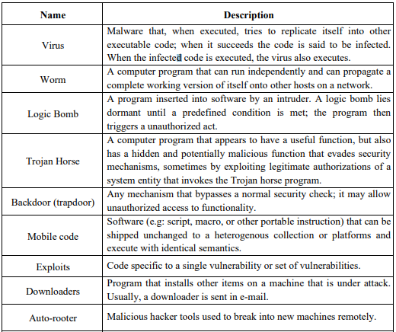
Malicious Software

Slide 45
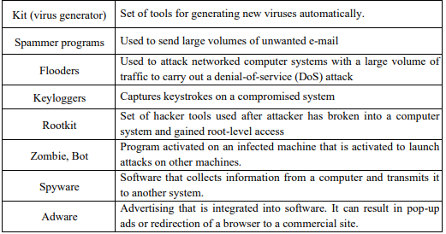
Malicious Software

Slide 46
Viruses Classification
A virus classification by target includes the following categories:
Boot sector infector: Infects a master boot record or boot record and spreads when a system is booted from the disk containing the virus.
File infector: Infects files that the operating system or shell consider to be executable.
Macro virus: Infects files with macro code that is interpreted by an application.

Slide 47
Viruses Classification
A virus classification by concealment strategy includes the following categories:
Encrypted virus: A portion of the virus creates a random encryption key and encrypts the remainder of the virus. The key is stored with the virus. When an infected program is invoked, the virus uses the stored random key to decrypt the virus.
Stealth virus: A form of virus explicitly designed to hide itself from detection by antivirus software. Thus, the entire virus, not just a payload is hidden.
Polymorphic virus: A virus that mutates with every infection, making detection by the “signature” of the virus impossible.
Metamorphic virus: As with a polymorphic virus, a metamorphic virus mutates with every infection. The difference is that a metamorphic virus rewrites itself completely at each iteration, increasing the difficulty of detection. Metamorphic viruses may change their behaviour as well as their appearance.

Slide 48
Virus Kits
Such a toolkit enables a relative novice to quickly create a number of different viruses. Although viruses created with toolkits tend to be less sophisticated than viruses designed from scratch, the sheer number of new viruses that can be generated using a toolkit creates a problem for antivirus schemes.

Slide 49
E-Mail Viruses
A more recent development in malicious software is the e-mail virus. The first rapidly spreading e-mail viruses, such as Melissa, made use of a Microsoft Word macro embedded in an attachment. If the recipient opens the e-mail attachment, the Word macro is activated.
Then, The e-mail virus sends itself to everyone on the mailing list in the user’s e-mail package.
The virus does local damage on the user’s system.

Slide 50
Antivirus Approaches
The ideal solution to the threat of viruses is prevention: Do not allow a virus to get into the system in the first place, or block the ability of a virus to modify any files containing executable code or macros.
Detection: Once the infection has occurred, determine that it has occurred and locate the virus.
Identification: Once detection has been achieved, identify the specific virus that has infected a program.
Removal: Once the specific virus has been identified, remove all traces of the virus from the infected program and restore it to its original state. Remove the virus from all infected systems so that the virus cannot spread further.
If detection succeeds but either identification or removal is not possible, then the alternative is to discard the infected file and reload a clean backup version. Advances in virus and antivirus technologssy go hand in hand.

